Slide 1


SRM INSTITUTE OF SCIENCE AND TECHNOLOGY
18ECP104L MASSIVE OPEN ONLINE COURSE-II
Artificial Intelligence for Breast Cancer Detection
BY
SHABRISH B
RA1911034010011
B.Tech ECE, SRM IST

Slide 2
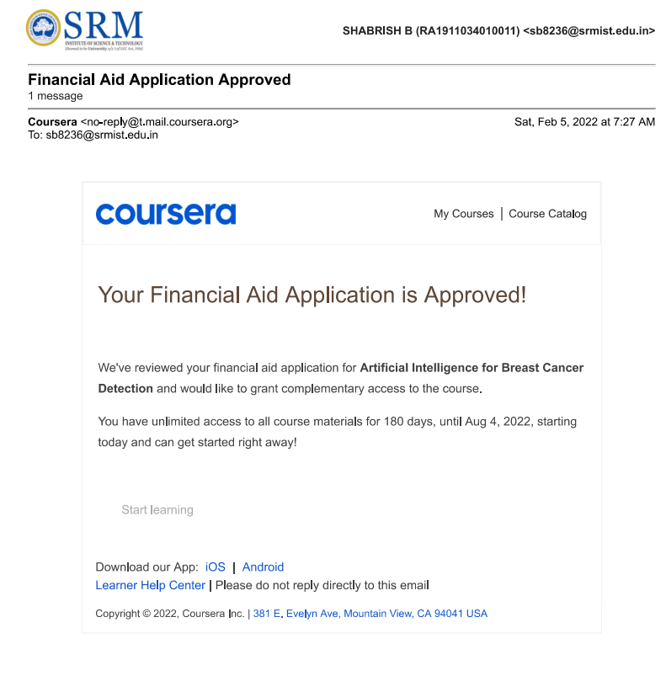
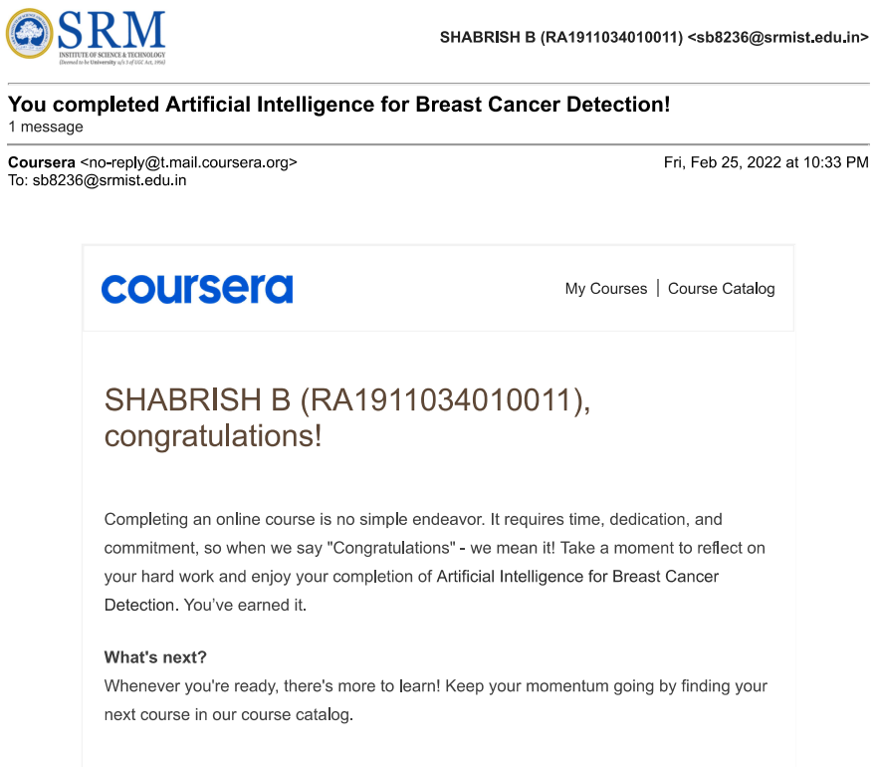
COURSE TIMELINE:
DATE OF ENROLLMENT: 07/02/2022
DATE OF COMPLETION: 21/02/2022

Slide 3
COURSE DETAILS:
COURSE TITLE : Artificial Intelligence for Breast Cancer Detection
COURSE DURATION : 4 WEEKS
OFFERING UNIVERSITY : Johns Hopkins University
COURSE TYPE :INTERMEDIATE

Slide 4

COURSE INSTRUCTOR:
Chung-Fu Chang:
Dr. Chung-Fu Chang has 35 years of experience in the research and development in Signal/Image Processing, Automatic Object Detection/Classification of various sensor modalities, and Synthetic Aperture Radar image formation processing..

Slide 5

Emily Ambinder:
Dr. Emily Ambinder is an Assistant Professor in the Johns Hopkins Medicine Department of Radiology and Radiological Science. She specializes in all aspects of breast imaging including mammography, tomosynthesis, breast ultrasound, breast MRI, and image-guided breast procedures.

Slide 6
ABOUT THE COURSE:
The course is designed for students who are interested in the career of product development using artificial intelligence and would like to know how AI can be applied to mammography.
The course content is focused on the AI processing paradigm along with the domain knowledge of breast imaging.

Slide 7
SYLLABUS OVERVIEW:
WEEK 1: Introduction to Breast Cancer and Breast Imaging
WEEK 2: Introduction of Artificial Intelligence.
WEEK 3: Mammographic Abnormalities
WEEK 4: AI Applications to Breast Cancer Detection

Slide 8
WEEK 1 :Introduction to Breast Cancer and Breast Imaging:
we have a brief introduction of breast cancer and breast imaging. In the United States, one in eight women will be diagnosed with breast cancer in her lifetime. In the United States, there are 40 thousand breast cancer deaths each year, making it the second leading cause of death in women.
When we talk about breast cancer, we often talk about the breast cancer receptors. Hormone receptors mean that tumor cells have receptors for either estrogen or progesterone.
This is important to know because certain therapies can target hormone-receptor positive tumors. The other important breast cancer receptor to know about is human epidermal growth factor receptor.
We translate these receptors statuses into breast cancer sub-types. the most common breast cancer sub-type is Luminal A. These are hormone receptor positive HER2 negative cancers and account for 73 percent of breast cancers and have the best overall prognosis.

Slide 9
WEEK 2: Introduction of Artificial Intelligence:
We will introduce the definitions of artificial intelligence in their context of this course, such as neural networks, perceptron, deep neural network. We will discuss the applications of the artificial Intelligence and its products available commercially.
The deep neural network is getting lots of attention in recent years due to its successful applications. The artificial intelligence refers to the machines that mimic human cognitive functions, such as learning and the problem solving.
We are going to discuss the processing paradigm of machine learning. You will learn the process of algorithm training and the test. We will explain each element in the processing paradigm.
This is an overview of the processing of machine learning based on our understanding of the sensor phenomenology. We choose to Sensor mortality and acquired image. In the image acquisition, several parameters are considered, such as the sampling rate, the coding scheme, and whether the data has been compressed.

Slide 10
WEEK 3:Mammographic Abnormalities:
In week 3 we have talked about typically benign calcifications. The ACR-BI RADS ATLAS is a great reference . This is a list of the typically benign calcifications that we will be reviewing in this lecture.
Let's start with milk of calcium. These calcifications have a very classic appearance and that they appear to change shape on different mammographic projections.
On the craniocaudal or CC view, the calcifications have a smudgy appearance and can be hard to see. On the lateral or ML view, calcifications appear to layer referred to as tea cupping. Here's an example of milk of calcium calcifications.
This lecture will be focused on suspicious calcifications. Again, the BI-RADS virus is a great reference for this topic. There are four distinct morphologies that we will be reviewing today, all considered suspicious on imaging, and requiring biopsy.
These are amorphous calcifications, coarse heterogeneous calcifications, fine pleomorphic calcifications, and finally fine linear branching calcifications. For each of these morphologies, I'll be referencing the corresponding positive predictive value. To review, positive predictive value is a percentage of suspicious findings that actually represent a cancer.

Slide 11
WEEK 4: AI Applications to Breast Cancer Detection:
Artificial Intelligence for breast cancer detection building classifier. In this lesson, we will discuss the objective of the Artificial Intelligence for breast cancer detection and understand the role of the AI can and should play.
In Module 2, we have discussed the AI processing paradigm, and in this lesson, we will discuss these processing elements, specifically for the breast cancer detection applications.
The objectives of AI for the breast cancer detection are to provide efficient computation for the computer aided diagnosis and to generate consistent classification results.
The idea of replacing radiologist with an AI system is far fetched. However, there have been significant progress made in the AI technology in recent years. The AI system can serve the radiologist as a value added tool, generating classification results with high detection and the low false alarm rates. The role of the AI in the breast cancer screening should be played as a second reader.

Slide 12
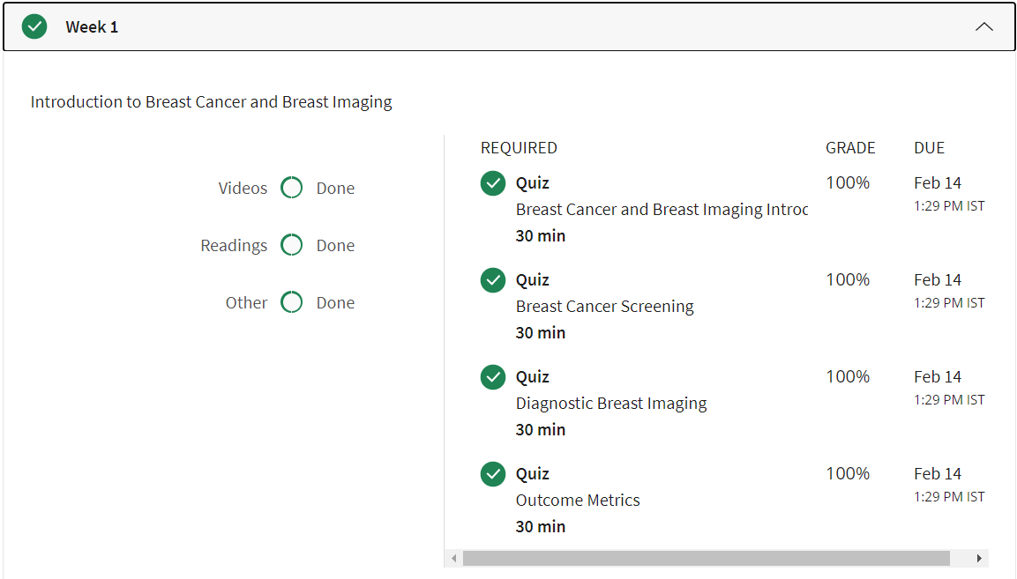
GRADE DETAILS:

Slide 13
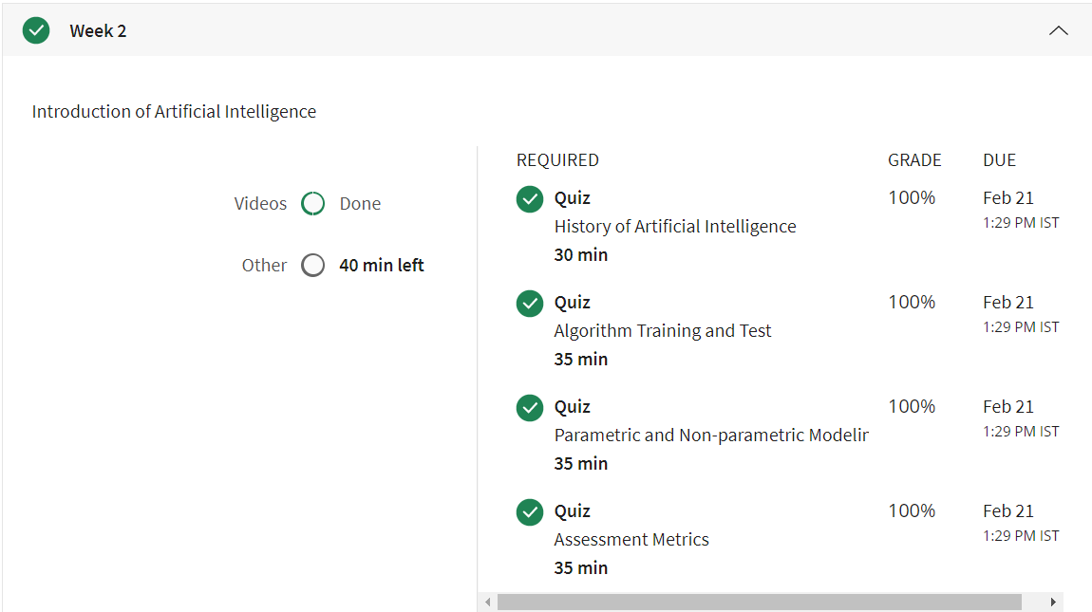

Slide 14
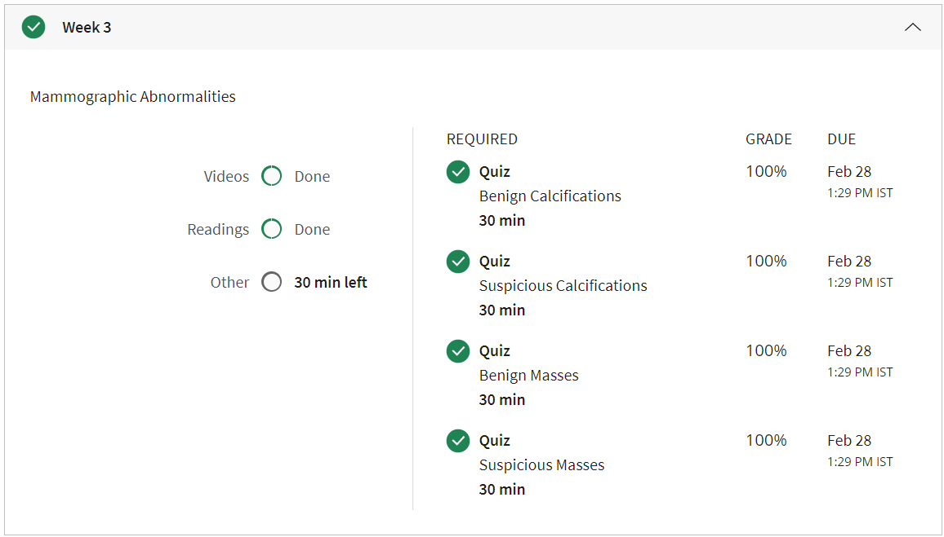

Slide 15
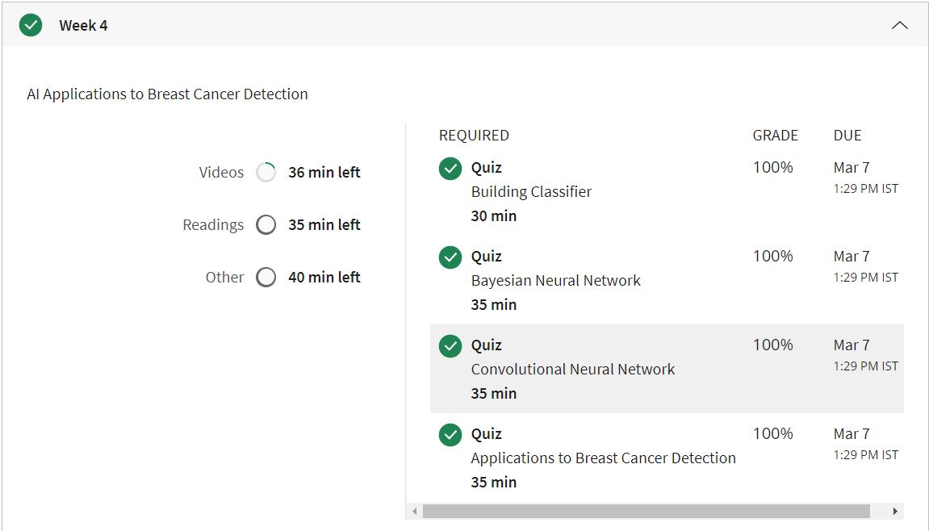

Slide 16
OBJECTIVES:
The objective of this course is to provide students the knowledge of artificial intelligence processing approaches to breast cancer detection.
This course approach is unique, providing students a broad perspective of AI, rather than homing in on a particular implementation method.
Students who complete this course will not only leverage the knowledge into an entry level job in the field of artificial intelligence but also perform well on projects because their thorough understanding of the AI processing paradigm.

Slide 17
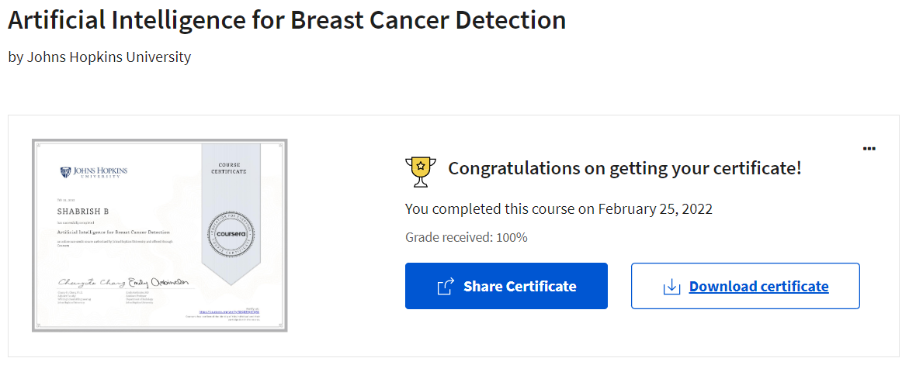
PROOF OF COURSE COMPELETION:

Slide 18
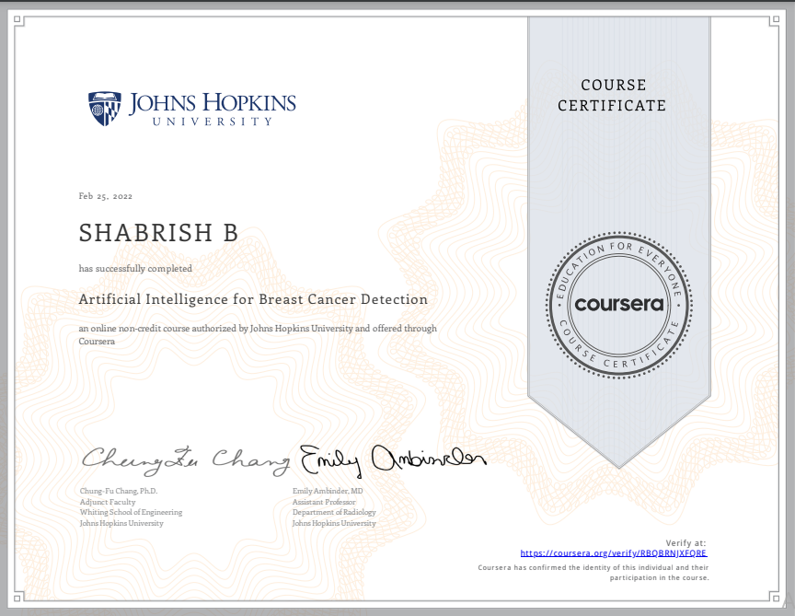
CERTIFICATE:

Slide 19
THANK YOU

